Slide 1

Project Handbook

Slide 2

Contents

Slide 3
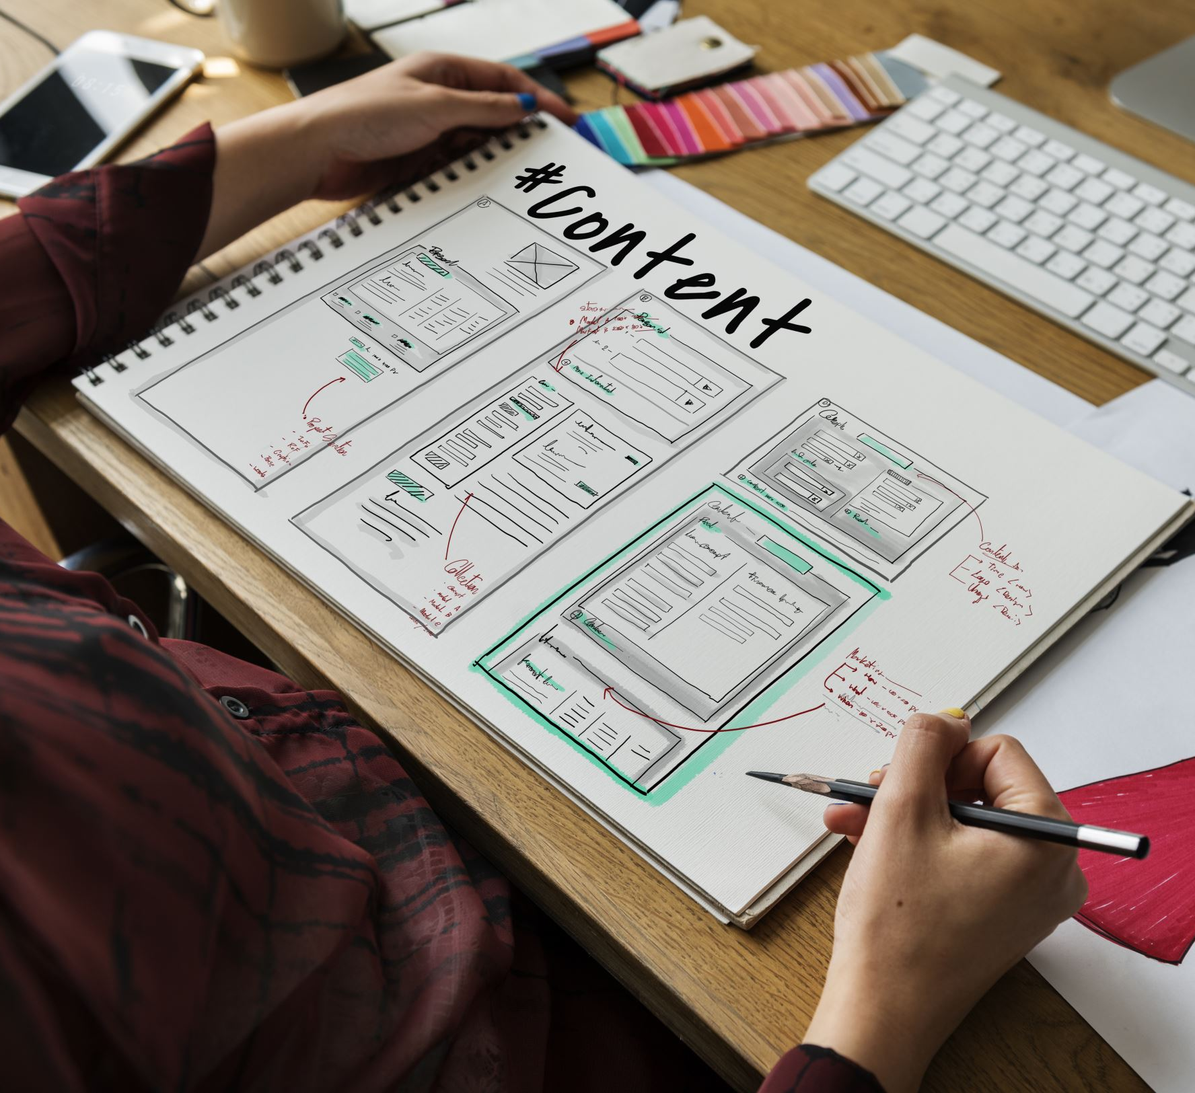
Introduction
Welcome to the project handbook for our clothing website
This website has been developed using HTML, CSS, and JavaScript, and features a database spreadsheet that has been normalized to ensure efficient data management
This handbook will provide an overview of the project, including its goals, design, and development process, as well as resources and guidelines for ongoing maintenance and improvements

Slide 4
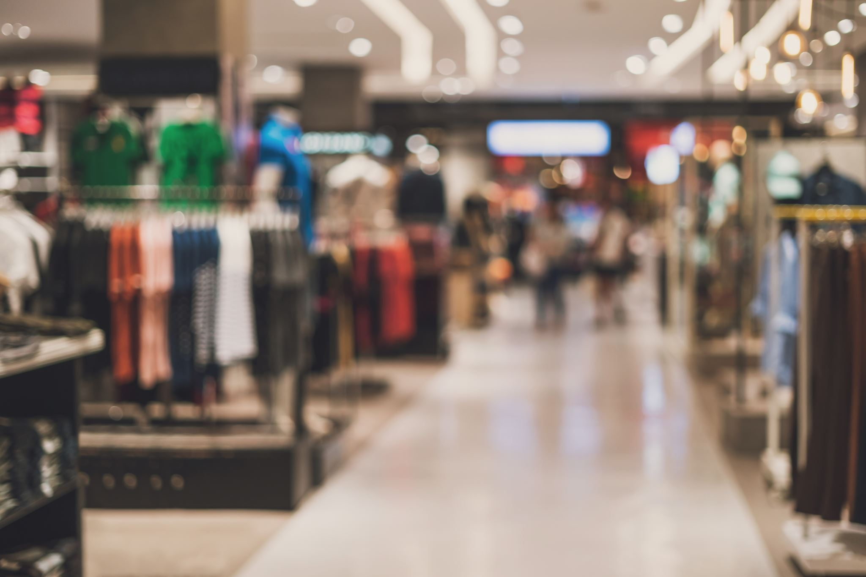
Project Specification
Project Specification: Bargain Rail
Scope: The website will feature a wide variety of clothing items for men, women, and children, including tops, bottoms, dresses, and outerwear
A fully functional and responsive e-commerce website
A customer registration and login system
A shopping cart feature
A search and filter function
A customer account management system
Inventory management (Add/Update/Delete)
Technologies: The website will be developed using HTML, CSS, JavaScript
Timeline: The development of the project is expected to take up the full year , with regular check-ins and progress updates with the Scrum Master and Customer

Slide 5
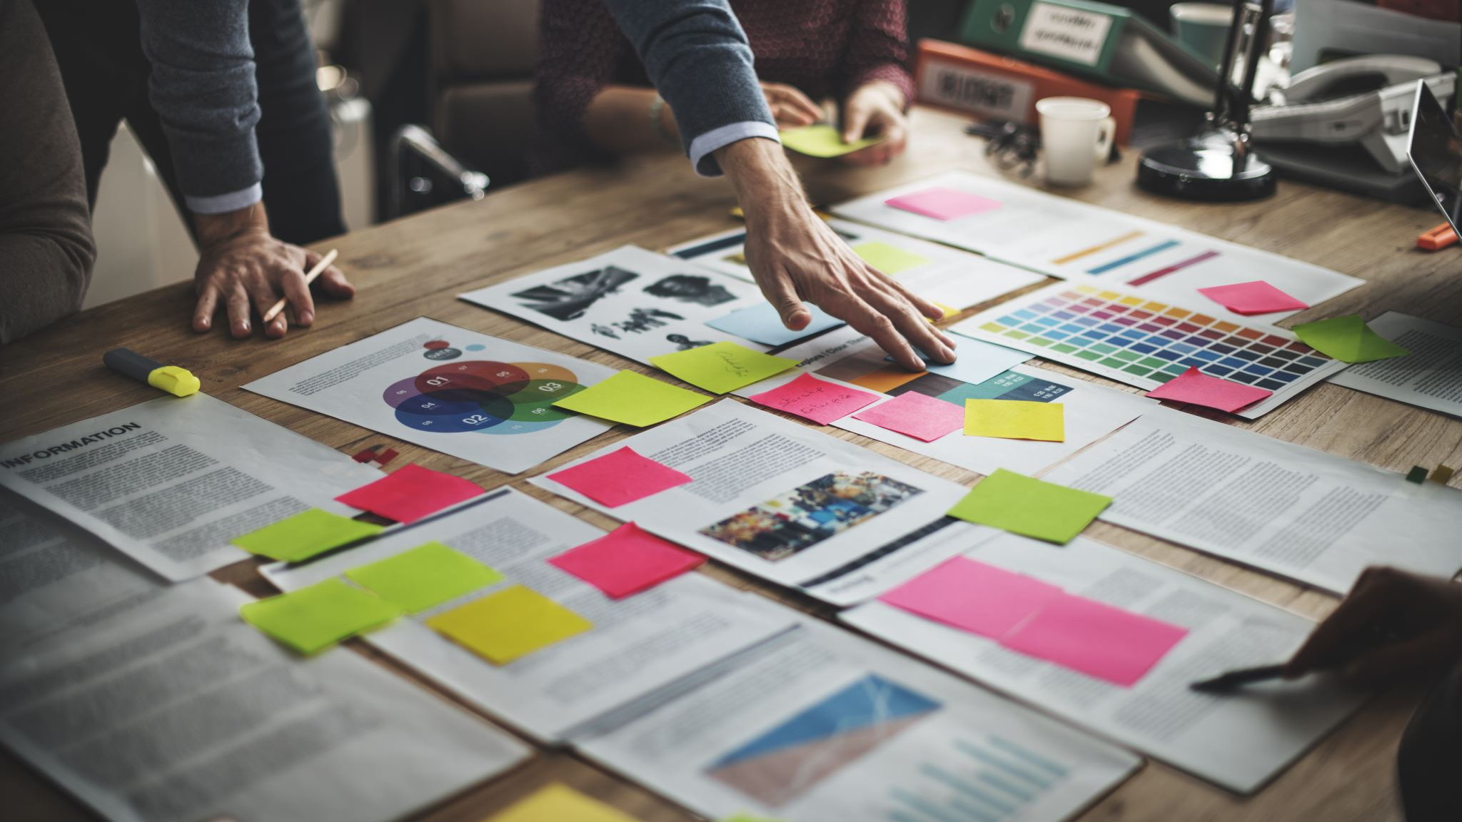
Use Stories/Cases
User stories are typically written from the perspective of the end user and focus on the value that a particular feature or functionality will provide
The main advantage of user stories is that they provide a clear and concise way to capture the user's needs and requirements, making it easier for the development team to understand the user's perspective and build a product that meets those needs
User stories also help to keep the development focused on delivering value to the user and can help to ensure that the final product is more likely to meet the user's needs and be successful

Slide 6
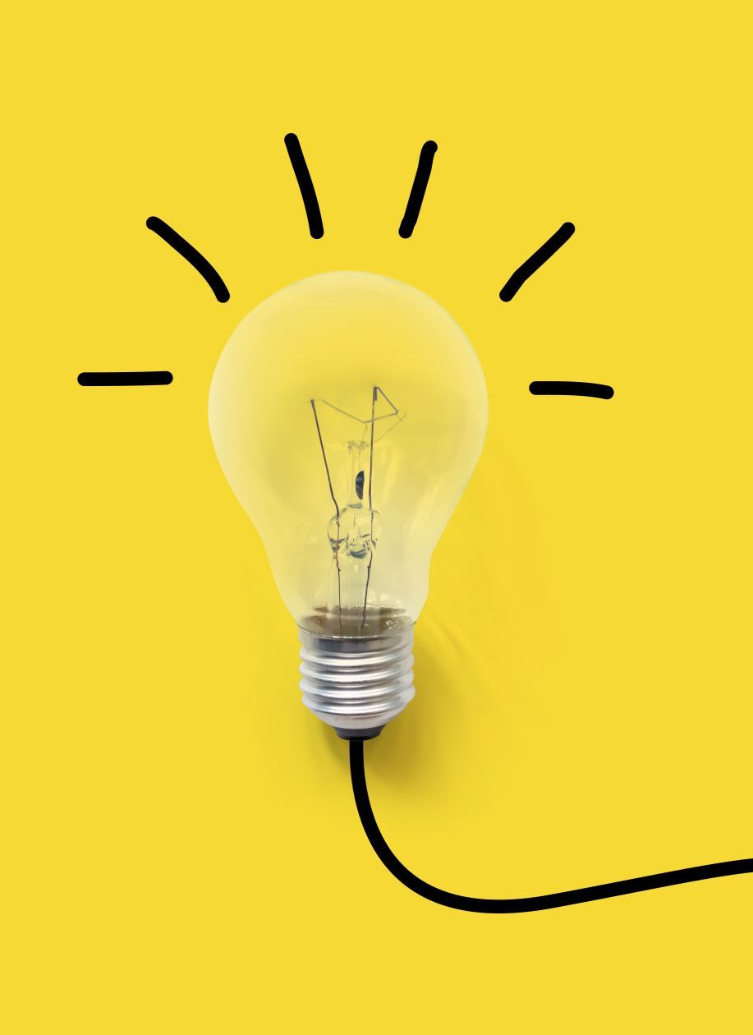
Agile methodology
Agile methodology is a project management approach that emphasizes flexibility and continuous improvement
It is based on the Agile Manifesto, a set of values and principles for software development that prioritize individuals and interactions, working software, and customer collaboration over processes and tools
Agile methodology is commonly used in software development but can also be applied to other types of projects

Slide 7
Mood Board
Instead, we chose to focus on creating a mood board that would represent a more professional and sophisticated look and feel for the website, as it would be more in line with the target audience and the overall brand image
This decision was made after we realized that the initial idea of a Hawaiian themed mood board didn't align with the overall aesthetic and tone that we wanted to achieve for the website
Ultimately, our decision to use a black and white themed mood board was the best choice for our website, as it helped to create a professional and sophisticated look and feel

Slide 8
Wireframes
Desktop View: Wireframes are simplified, low-fidelity visual representations of a website or application's layout and structure
They are commonly used in the early stages of website or app design to establish the overall layout and organization of content and functionality, before moving on to more detailed design elements such as color and branding
Wireframes are an important tool in the web design process as they help to establish the structure and layout of a website or app and allow for easy communication and collaboration between the design team and other stakeholders

Slide 9
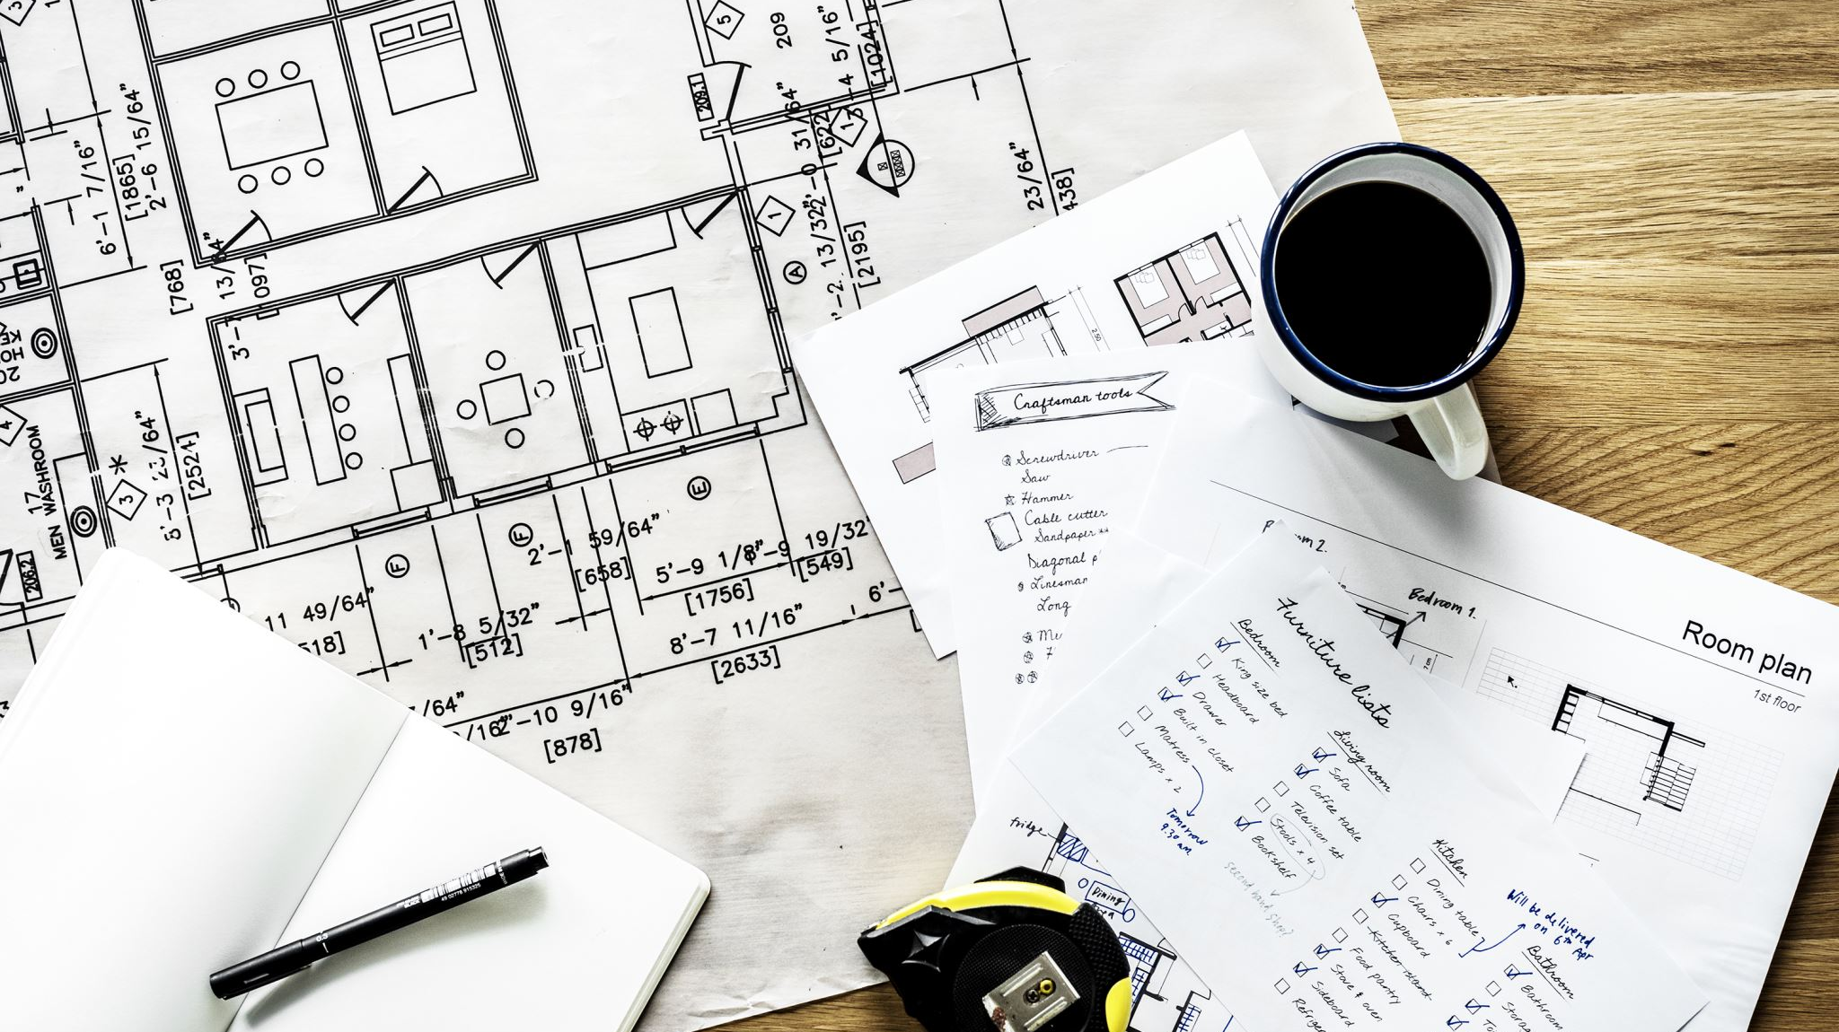
Prototypes
Men's page: In developing our Bargain Rail website, we created a prototype for the men's page that included a main image and a grid layout design for displaying the clothing items
However, after reviewing the prototype, we decided that the main image did not align with the overall aesthetic of the page and decided to change it
We decided to keep a main image for the home/landing page as we felt that was needed and looked great but for the other pages, we decided to stick to a grid layout along with a footer that had animated waves which we used JavaScript for
The grid layout design was a clear, organized way to present the products, so it was decided to keep that same design style on all other pages.

Slide 10
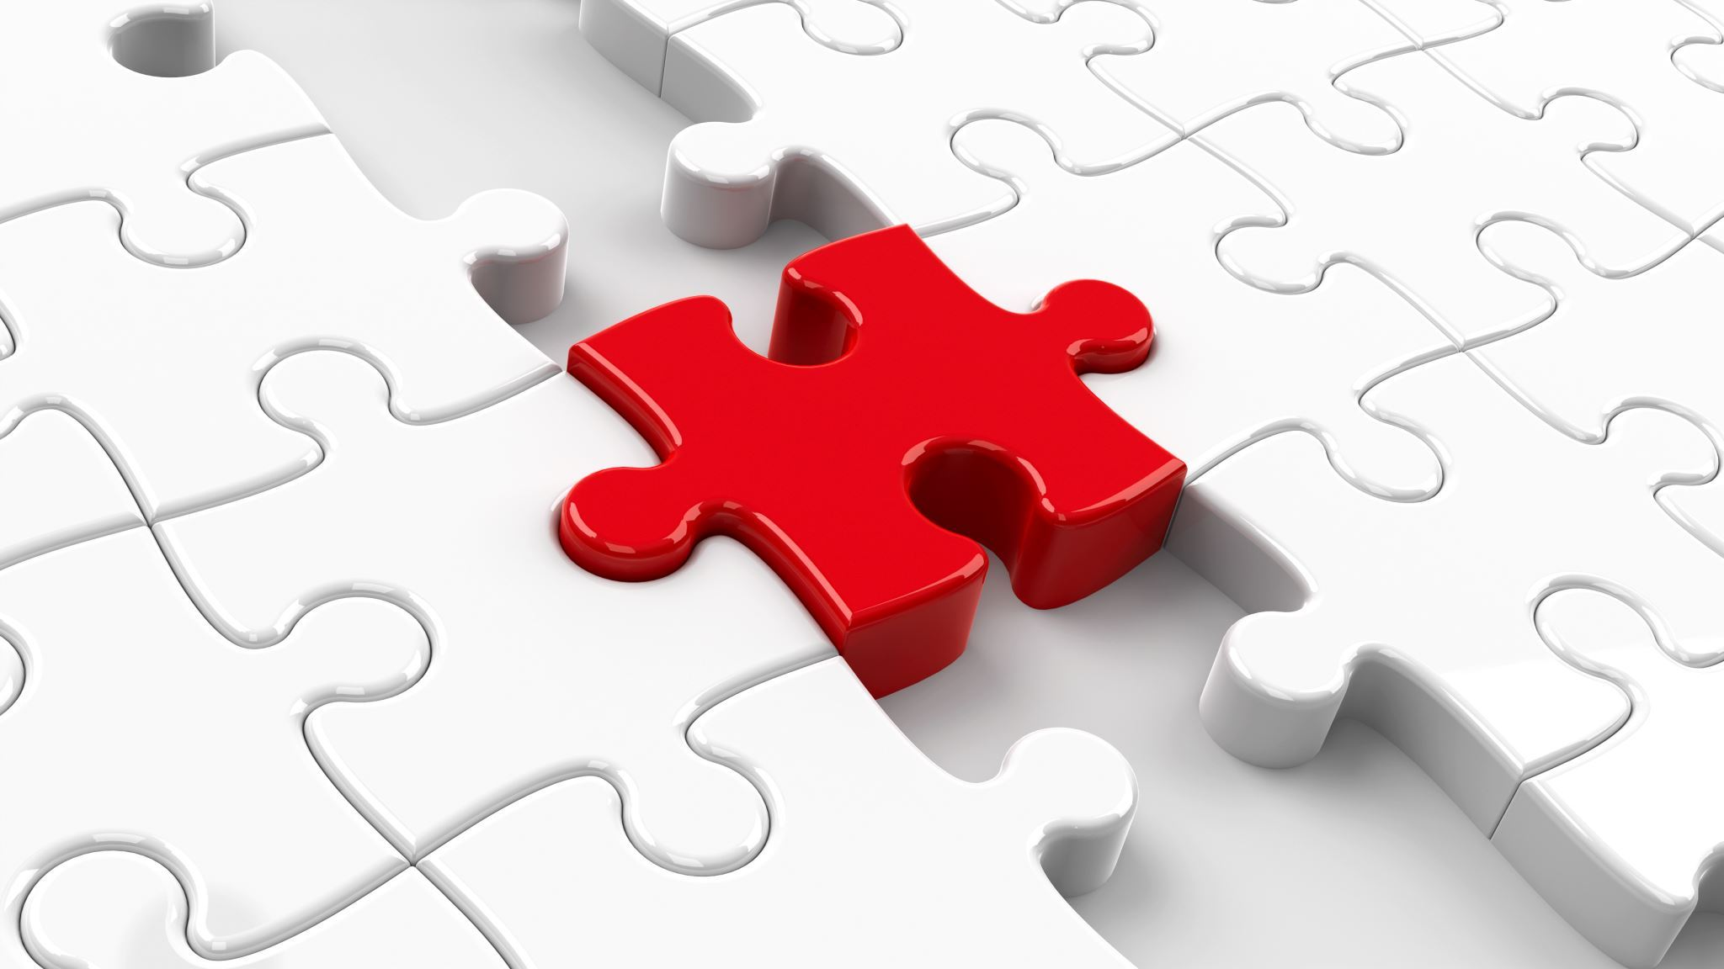
Prototypes
By creating a prototype and testing it, we were able to identify areas that needed improvement and make changes before moving forward with the final design. This allowed us to make sure that the website would meet the needs of its users and provide a visually appealing experience.

Slide 11
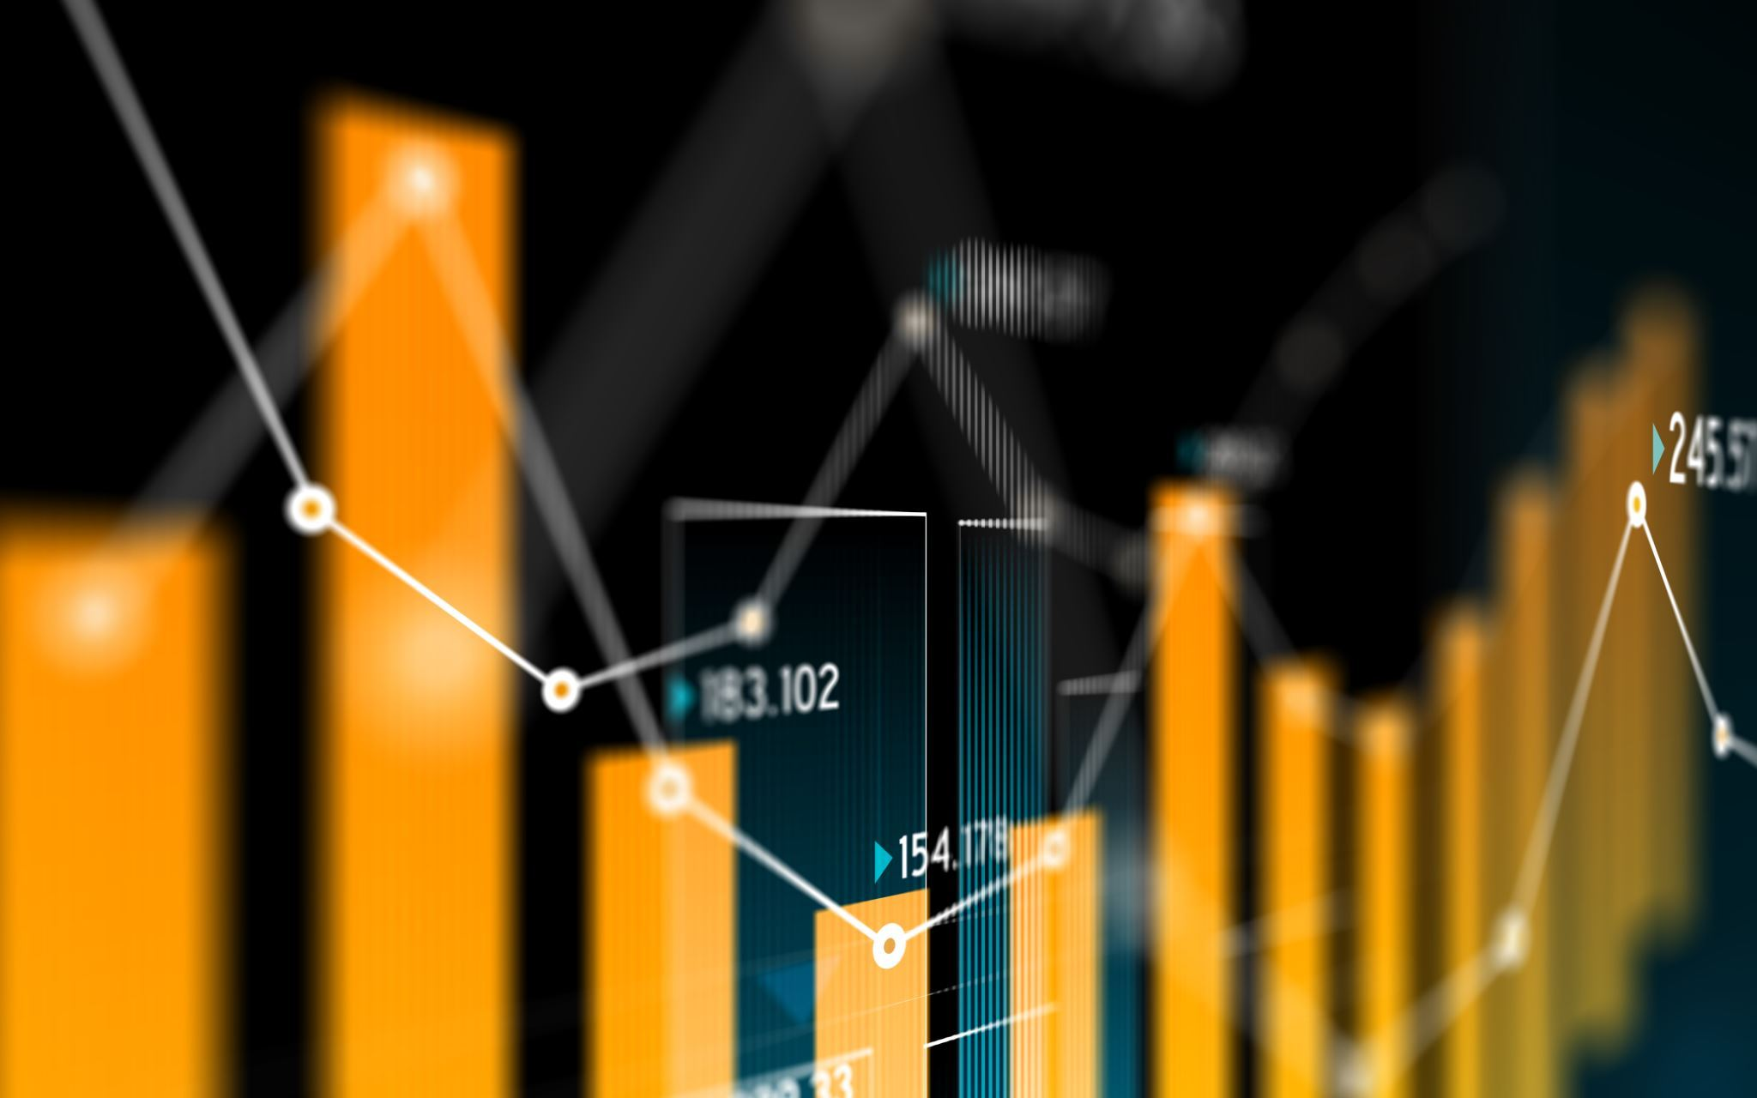
Database design
Spreadsheet: A database spreadsheet is a table that is used to organize and store data in a structured format
It is like a traditional spreadsheet, such as Microsoft Excel or Google Sheets, but with additional functionality for working with and manipulating large amounts of data
A database spreadsheet typically includes rows and columns, with each row representing a single record and each column representing a field or attribute of that record
We used Visual Paradigm to create a clear and logical link between all the tables in the database, this helped us to ensure that all the data was properly organized and easy to access

Slide 12

Website design
Our current website development is mostly complete, with the home, men's, women's, children's, jewellery, and on sale pages all being completed (besides some small bugs)
The product pages have been designed and implemented, allowing users to easily view and learn more about the products we offer
One of the main tasks that still needs to be done is to add at least one product to every page, this will help users to see what types of products we offer and help to increase engagement and sales

Slide 13
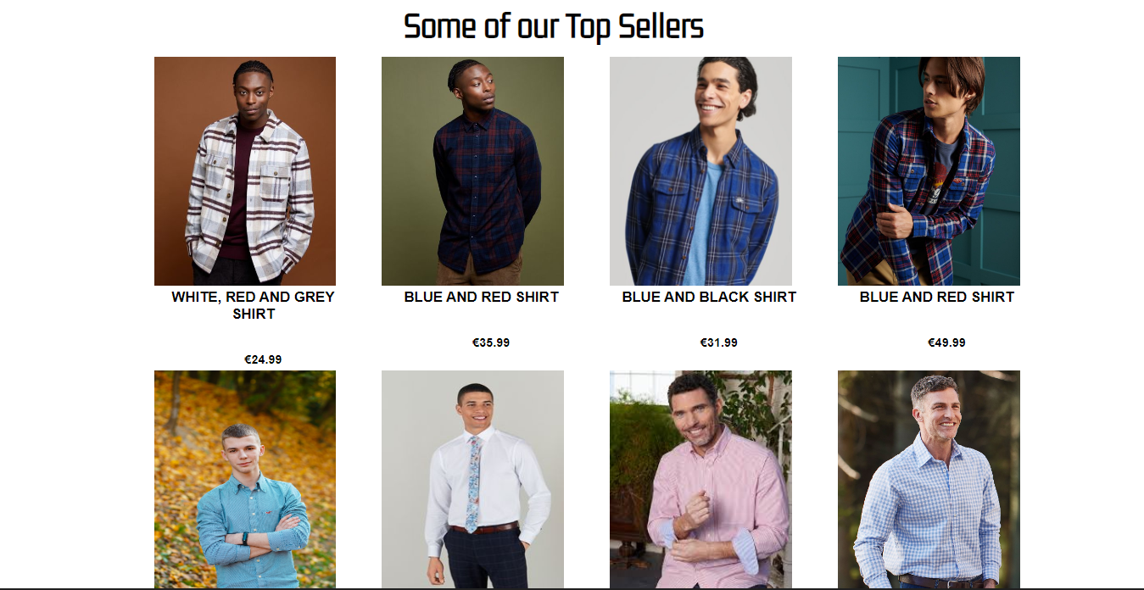
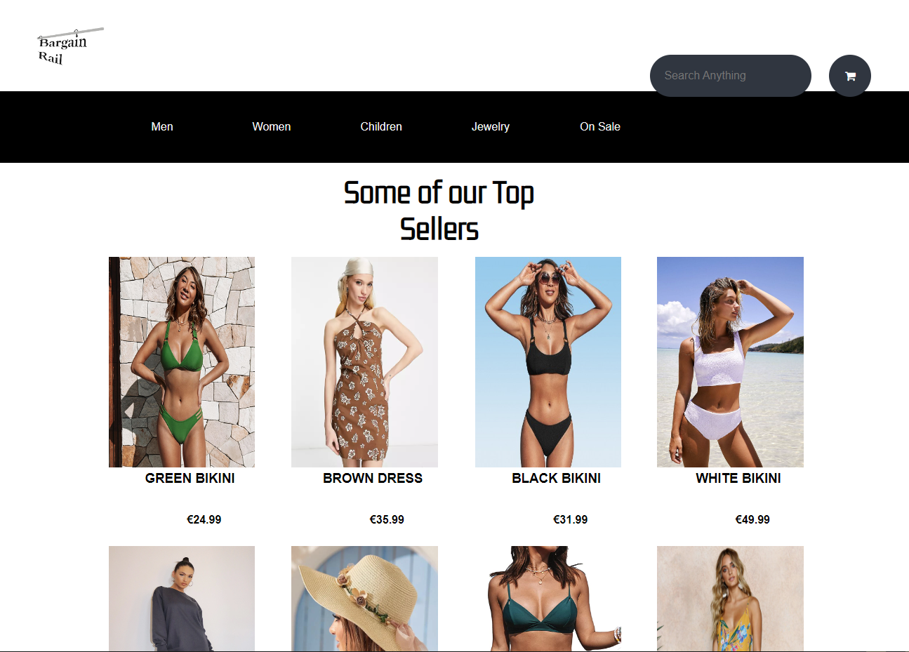
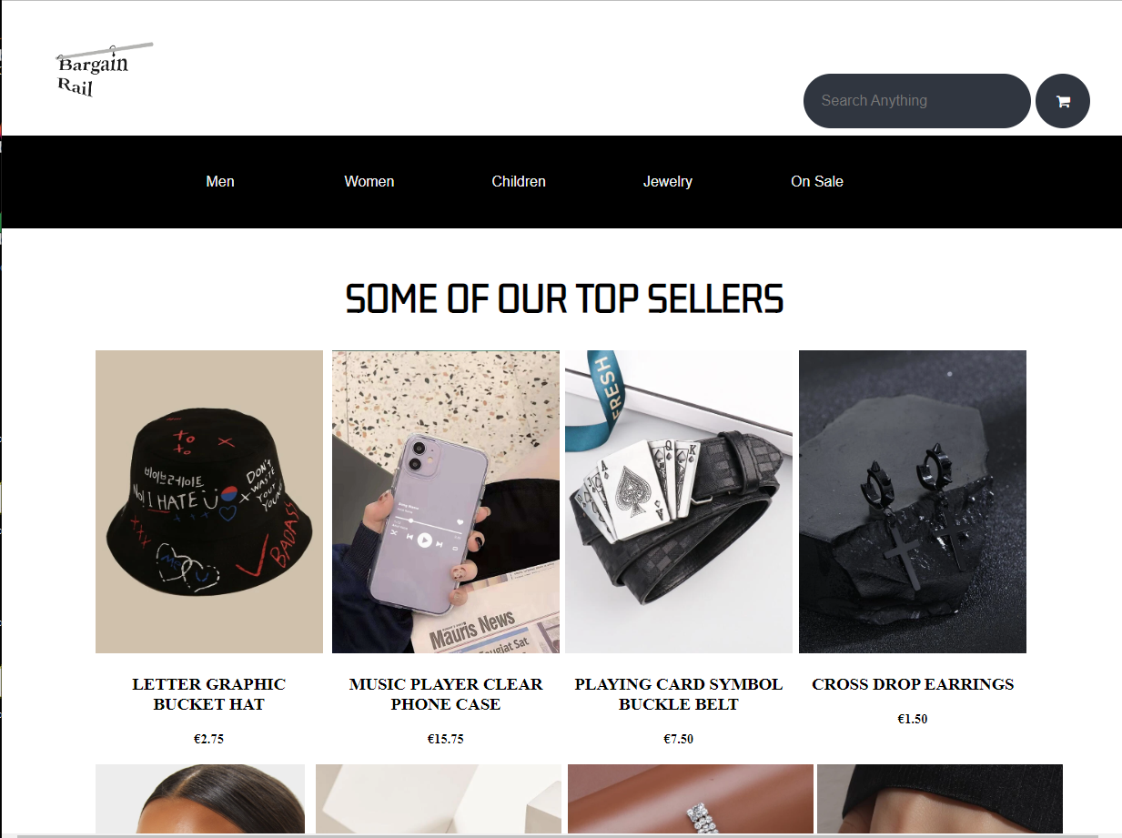
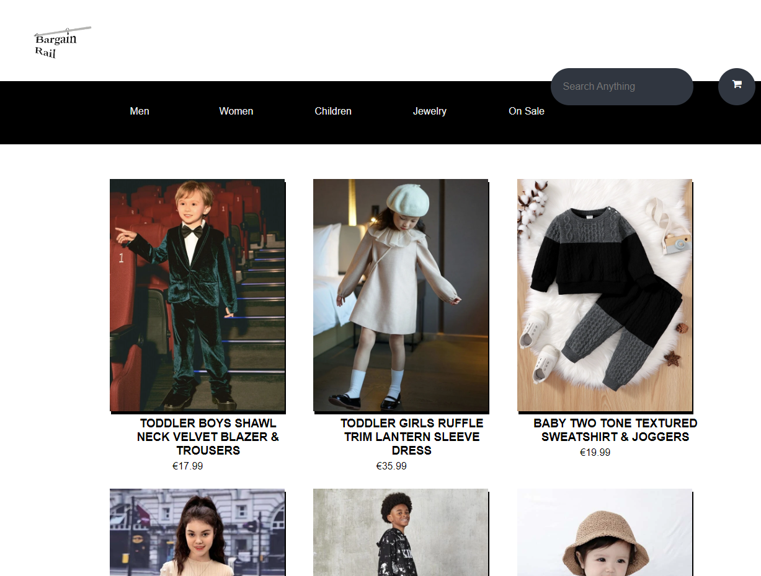

Slide 14
